Slide 1
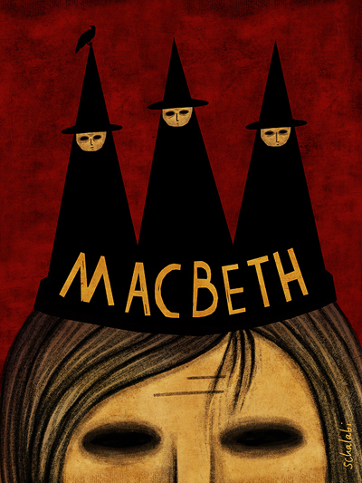
LEARNING OBJECTIVE:
To understand what to include and how to respond to exam style questions.
Keywords:
Language/dramatic techniques
Context/witchcraft and the Supernatural
Themes
Shakespeare’s intent…
Effect on audience…
LEARNING OUTCOMES:
Explain how the supernatural impacts the character. AO1
Select a range of quotations/language and dramatic devices to support their response. AO2
Use contextual knowledge to analyse how the supernatural is used as a key theme in the play. AO3
The Exam Task:
Starting with the extract, explain how far you think Shakespeare presents the character of Macbeth as being influenced by witchcraft and the supernatural.
Write about:
how Shakespeare presents Macbeth in this speech (15marks)
how Shakespeare presents Macbeth’s link to witchcraft and the supernatural in the play as a whole (15 marks) + 4 marks (AO4)

Slide 2
GCSE English Literature - Paper 1: Shakespeare and the 19th Century Novel
Section A – Macbeth
AO1: Clear explained response to task and ‘Macbeth’ text.
Effective use of references from the play to support explanation.
Clear writing and well selected quotations
AO2: Clear explanation of Shakespeare’s methods/techniques.
Understanding of effects of Shakespeare’s methods/techniques on the audience.
Do you understand how dramatic irony/stage directions/Soliloquy/Asides are used?
AO3: Clear understanding of ideas/perspectives/contextual factors shown by specific links between Jacobean era/Macbeth text and the task.
Context of the play
AO4: Learners spell and punctuate with consistent accuracy, and consistently use
vocabulary and sentence structures to achieve control of meaning.
SPaG

Slide 3
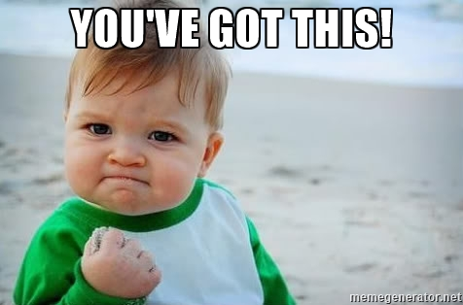
LEARNING OBJECTIVE:
To understand what to include and how to respond to exam style questions.
LEARNING OUTCOMES:
Explain how the supernatural impacts the character. AO1
Select a range of quotations/language and dramatic devices to support their response. AO2
Use contextual knowledge to analyse how the supernatural is used as a key theme in the play. AO3
How do you approach this task?
Underline the key focus of the task.
Read the extract and underline/highlight all the key words and phrases that are linked to witchcraft and the supernatural (these are your quotes).
Annotate each with the language or dramatic technique (verb, adjective, pathetic fallacy, simile, symbolism etc.) Make brief notes on links to context.
Start at the top of the extract, using the full PQA structure to answer the first bullet point, embedding and analysing all the quotes you highlighted.
Starting with the extract, explain how far Shakespeare presents the character of Macbeth as being influenced by witchcraft and the supernatural.
Write about:
how Shakespeare presents Macbeth in this speech (15marks)
how Shakespeare presents Macbeth’s link to witchcraft and the supernatural in the play as a whole (15 marks)
You’ve done this over and over before!

Slide 4
Is this a dagger which I see before me,
The handle toward my hand? Come, let me clutch thee.
I have thee not, and yet I see thee still.
Art thou not, fatal vision, sensible
5 To feeling as to sight? or art thou but
A dagger of the mind, a false creation,
Proceeding from the heat-oppressed brain?
I see thee yet, in form as palpable
As this which now I draw.
10 Thou marshall'st me the way that I was going;
And such an instrument I was to use.
Mine eyes are made the fools o' the other senses,
Or else worth all the rest; I see thee still,
And on thy blade and dudgeon gouts of blood,
15 Which was not so before. There's no such thing:

Slide 5
It is the bloody business which informs
Thus to mine eyes. Now o'er the one halfworld
Nature seems dead, and wicked dreams abuse
The curtain'd sleep; witchcraft celebrates
20 Pale Hecate's offerings, and wither'd murder,
Alarum'd by his sentinel, the wolf,
Whose howl's his watch, thus with his stealthy pace.
With Tarquin's ravishing strides, towards his design
Moves like a ghost. Thou sure and firm-set earth,
25 Hear not my steps, which way they walk, for fear
Thy very stones prate of my whereabout,
And take the present horror from the time,
Which now suits with it. Whiles I threat, he lives:
Words to the heat of deeds too cold breath gives.
[a bell rings]
I go, and it is done; the bell invites me.
Hear it not, Duncan; for it is a knell
That summons thee to heaven or to hell.

Slide 6
Act 2 Scene 1 – Dagger hallucination
Is this a dagger which I see before me,
The handle toward my hand? Come, let me clutch thee.
I have thee not, and yet I see thee still.
Art thou not, fatal vision, sensible
To feeling as to sight? Or art thou but
A dagger of the mind, a false creation,
Proceeding from the heat-oppressèd brain?
I see thee yet, in form as palpable
As this which now I draw.
Thou marshall’st me the way that I was going,
And such an instrument I was to use.
Mine eyes are made the fools o' th' other senses,
Or else worth all the rest. I see thee still,
And on thy blade and dudgeon gouts of blood,
Which was not so before. There’s no such thing.
It is the bloody business which informs
Thus to mine eyes. Now o'er the one half-world
Nature seems dead, and wicked dreams abuse
The curtained sleep. Witchcraft celebrates
Pale Hecate’s offerings, and withered murder,
Alarumed by his sentinel, the wolf,
Whose howl’s his watch, thus with his stealthy pace,
With Tarquin’s ravishing strides, towards his design
Moves like a ghost. Thou sure and firm-set earth,
Hear not my steps, which way they walk, for fear
Thy very stones prate of my whereabout,
And take the present horror from the time,
Which now suits with it. Whiles I threat, he lives.
Words to the heat of deeds too cold breath gives.
Macbeth’s second soliloquy in the play.
Confused about whether the dagger is real or a figment of his imagination.
Calls it a ‘fatal vision’ arising from ‘a heat oppressed brain’ which shows that he is stressed about committing this deed.
Feels that his senses/mind are playing tricks on him, especially when the dagger reappears with blood on it – it leads him to Duncan’s chamber.
Macbeth refers to negative imagery of darkness, nightmares, witchcraft, ghosts and wolves, shows how the evil of the witches and his own dark thoughts have consumed him.
Asks the earth to remain silent so that his footsteps cannot be heard whilst he commits this evil deed.
Says that the more he thinks about the deed, the weaker he becomes so he needs to go ahead with it quickly.

Slide 7
Learning Objective:
To understand what to include and how to respond to exam style questions.
Explain how the supernatural impacts the character. AO1
Select a range of quotations/language and dramatic devices to support their response. AO2
Use contextual knowledge to analyse how the supernatural is used as a key theme in the play. AO3
Key theme – Supernatural
Effect on audience: Shakespeare’s era – Fearful of the witches’ power and Banquo’s challenge.
AO3 Context: Reference to beliefs about witches; they could predict the future.
Connotations – Banquo does not fear them and tests the validity of their words.
“If you can look into the seeds of time and say which
seeds will grow and which will not, speak, then to me
who neither beg nor fear your favours or your hate.”
AO2 – ‘Seeds’ are a metaphor for the passage of time and for having children. Banquo challenges the witches to give him prophecies too. Also foreshadows that fact that Banquo’s ‘seeds’ will be future Kings.
Meaning – Banquo diverts attention away from Macbeth; he is suspicious of the witches, especially when he sees how Macbeth seems to be consumed by their words. He even associates them to the devil…tempting Macbeth with their prophecies.

Slide 8
Look at the following quotations and answer the following questions:
What can you write about its meaning?
The language/dramatic devices used?
Effect on the audience?
Context of the play?
Connotations of any of the words?
Link to any of the other Key themes?
Macbeth – Act 1 Scenes 1 and 3
“Fair is foul and foul is fair.”
“All hail Macbeth, hail to thee that shalt be King hereafter!”
“If you can look into the seeds of time and say which
seeds will grow and which will not, speak, then to me
who neither beg nor fear your favours or your hate.”
Prompts
Basic
Implies...
Suggests...
Demonstrates...
connotes...
Highlights... infers...
More than a basic - Better
This also...
Another...
In addition...
Furthermore...
Taking this further...
Perhaps...
Maybe...
Further analysis - Best
The author might be...
Elsewhere in the text
This links to the idea
This supports the point
Most will be able to select a range of quotations/language devices to support their response. AO2

Slide 9
SELF/PEER ASSESSMENT
Based on the exemplars we’ve just examined, and using the marksheet attached, how well did you do on the homework task?
WWW-
EBI-

Slide 10
First bullet point – Focus on the extract
EXAMPLE 1
Shakespeare shows the influence of witchcraft and the supernatural from the beginning of the extract by the use of a rhetorical question; “Is this a dagger I see before me, the handle toward my hand?” This suggests that Macbeth has a very powerful imagination triggered by the witches predictions. It also demonstrates the power the witches have over him as he is about to commit regicide which is a terrible sin against God and man as Kings were believed to be appointed by God in that era.
Macbeth is clearly hallucinating- a sign of madness caused by associating with the witches. This would engage audiences to see a once powerful Lord and leader of the army in such a state of confusion. He sees a “dagger of the mind” implying that its is an imaginary dagger; which suggests evil and supernatural forces tricking him. Macbeth acknowledges that it is a “fatal vision” demonstrating his fear about killing King Duncan. The adjective “fatal” helps to convey the imagery not only of King Duncan’s death but also foreshadows his mental breakdown after committing the crime, and his death at the end of the play.
The power of witchcraft and the supernatural can also be seen in the verb phrase “thou marshall’st me…” suggesting that he wasn’t in control of his actions but that he was being steered by the power of the witches.

Slide 11
He feels that his mind is playing tricks on him, “Mine eyes are made the fools o' th' other senses”, suggested by the “gouts of blood” on the imaginary dagger, which was leading him to Duncan’s room . A man of his status is expected to know better and therefore this would be seen as evil, as he is clearly being driven by greed and ambition. It wasn’t unusual of men in that era to want ultimate power.
Macbeth also uses negative imagery of darkness, nightmares, witchcraft, ghosts and wolves, demonstrating that the evil of the witches and his own dark thoughts are overpowering him. This creates an eerie atmosphere of the speech. He also mentions “Hecate”, the goddess of witchcraft as a strong presence - preparing her sacrificial victims. This could mean both Duncan and Macbeth, since he becomes a victim of his own obsession with witchcraft and becomes the tragic hero. The implication is that Macbeth is Duncan’s “trusted watchman”, and the “wolf”, which moves “like a ghost”, towards his prey- Duncan. The use of the animal imagery contrasts with the simile of “a ghost”, inferring Macbeth’s change from a fierce warrior to an evil phantom. Just as talk of the murder makes him start to have doubts again, (showing that he knows right from wrong, and good over evil), his evil thoughts is interrupted by the “bell”, a signal from Lady Macbeth that it is time to do the deed.

Slide 12
SELF/PEER ASSESSMENT
Based on the exemplars we’ve just examined, and using the marksheet attached, how well did you do on the homework task?
WWW-
EBI-

Slide 13
EXAMPLE 2
Shakespeare’s Macbeth, set in 11th century Scotland, shows the influence of witchcraft and the supernatural on the protagonist Macbeth, (the once, loyal, heroic leader of the army who led Scotland to victory against the Norwegians) evident from the beginning of the extract.
After deciding to go through with the "terrible feat” of murdering King Duncan, he sits alone, waiting for the bell which will summon him to murder Duncan, pondering his decision one final time. Shakespeare’s use of a rhetorical question; “Is this a dagger I see before me, the handle toward my hand?” is the first glimpse of Macbeth's powerful imagination – an imagination arguably triggered by the witches predictions, which led to him to this point; about to commit regicide – the ultimate crime and sin against God and man; since Kings were believed to be appointed by God in that era. Clearly hallucinating, the question would dramatically engage audiences, presenting Macbeth’s confusion about whether the dagger is real or simply a figment of his imagination, which links directly to their first encounter with the witches where Banquo extrapolated this same sentiment about the “old hags”. This imaginary “dagger of the mind” is therefore a supernatural entity that Macbeth himself acknowledges is a “fatal vision” arising from ‘a heat oppressed brain’ demonstrating his paranoia and terror about committing this deed, inevitably foreshadowing the mental trauma he suffers after committing the crime.

Slide 14
The power of witchcraft and the supernatural can also be seen in the verb phrase “thou marshall’st me…” almost personifying the phantom dagger – as though he wasn’t in control of his actions but rather being controlled or steered by this ghostlike, paranormal force. He feels that his senses are playing tricks on him, “Mine eyes are made the fools o' th' other senses”, especially when the dagger reappears stained with imaginary “gouts of blood” on it, and leads him to Duncan’s chamber. Again, Banquo had warned him of this deception by the “instruments of darkness” when he first became so “rapt” in his thoughts after the predictions.
Macbeth states that “nature seems dead”. The personification of “nature” here subliminally refers to the natural order of things being reversed or taken over by supernatural forces, and the negative imagery of darkness, nightmares, witchcraft, ghosts and wolves, that follow, connotes that the evil of the witches and his own dark thoughts have consumed him. The ominous and eerie atmosphere of the speech is enhanced by the use of successive allusions to people and practices which conjure up images of satanic and earthly evil. “Hecate”, the goddess of witchcraft has a strong presence overall in Macbeth - preparing her sacrificial victims, and Murder himself, summoned by his trusted watchman (Macbeth) , the “wolf”, moves with the power and speed of evil king “Tarquin”- “like a ghost”, towards his prey- Duncan.
Just as talk of the murder is about to stifle his courage, Macbeth's intense illusion is shattered by the “bell”, a signal from Lady Macbeth that Duncan's chamberlains are asleep, and Macbeth races away to commit the heinous crime.

Slide 15
how Shakespeare presents Macbeth’s link to witchcraft and the supernatural in the play as a whole (15 marks)
Elements of the Supernatural that are presented in ‘Macbeth’:
1. The three Witches - Act 1 Scene 1, Act 1 Scene 3, Act 3 Scene 5, Act 4 Scene 1.
2. Dagger hallucination – Act 2 Scene 1 Already done in the first half.
3. Banquo’s Ghost – Act 3 Scene 4
4. Images of Hell – Act 2 Scene 3 (Porter’s speech)
5. The Apparitions – Act 4 Scene 1
6. Madness – Act 2 Scene 1, Act 3 Scene 4, Act 5 Scene 1
REMEMBER! You are writing this section from your memory of the key events of the play as a whole:
Be selective from all the key scenes.
Yes. There is going to be much less quotes and more paraphrasing.
Yes. You will remember (provided you revise the text) some key words and short phrases which you will put in quotes.
Start from the beginning of the play selecting bits to discuss, to the end.

Slide 16
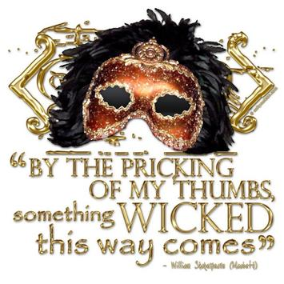
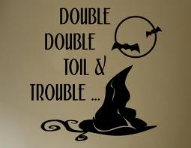
Learning Objective:
To understand what to include and how to respond to exam style questions.
Explain how the supernatural impacts the character. AO1
Select a range of quotations/language and dramatic devices to support their response. AO2
Use contextual knowledge to analyse how the supernatural is used as a key theme in the play. AO3
how Shakespeare presents Macbeth’s link to witchcraft and the supernatural in the play as a whole (15 marks)
Beliefs in witchcraft and the supernatural were common in Shakespeare’s era, particularly as King (James 1st) himself believed in them. Shakespeare starts the play with pathetic fallacy “thunder and lighting,” and the witches enter rather than the title character. This dramatic technique creates a dark and sinister atmosphere from the outset; frightening for audiences, particularly in Shakespeare’s era. It also demonstrates that the witches will have a huge impact on the course of events – creating a sense of mystery. The alliterative, oxymoronic declaration by the witches that “fair is foul and foul is fair” implies that things will not be the way they appear, as we know that they have an evil plan to destroy Macbeth – demonstrating a key theme of appearance vs reality. The effects of the supernatural can be seen when Macbeth echoes the same observation “so foul and fair a day I have not seen”, depicting his thought process clearly aligning with the witches. No wonder a man of his status; driven by greed and ambition, is soon captivated by the witches power and commands them to “stay you imperfect creatures, tell me more”. This can be seen as the beginning of his downfall and change from a godly figure to an evil person, communicating with the “agents of darkness”

Slide 17
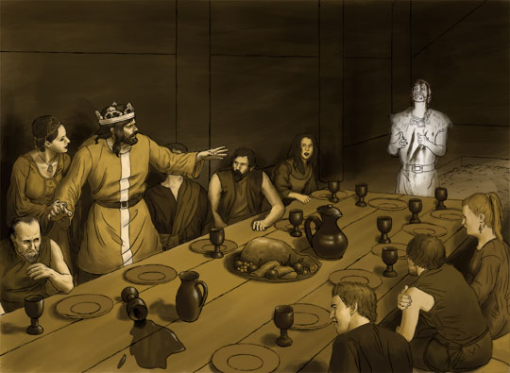
In the banquet scene for his coronation, he again starts to hallucinate seeing Banquo’s ghost seated in his chair. His thoughts are now clearly being controlled by images of the supernatural and …….
Images of Hell in the porter’s speech after the killing of Duncan also……..
His reliance and dependence on the witches become more apparent when he revisits them and is given further appartions….
The play ends with his continued decent into madness; afraid of ……
http://www.slideshare.net/meaglesham1/supernatural-elements-in-macbeth-10359154
Simply give a synopsis of how the key theme (witchcraft and the supernatural) is presented by Macbeth throughout the play.

Slide 18
SELF/PEER ASSESSMENT
Based on the exemplars we’ve just examined, and using the marksheet attached, how well did you do on the homework task?
Give yourself a mark out of 30 + a mark out of four.
WWW-
EBI-

Slide 20
General points to note about the Supernatural in Macbeth:
The witches are unnatural, supernatural beings. Banquo calls them ‘instruments of darkness” suggesting their devilish qualities and the fact that the things that they say are not as they seem. They are evil, their prophecies in Act 1 Scene 3 tempt Macbeth to actually kill the rightful King; the witches predictions of greatness are true BUT they don’t tell Macbeth about the price he will have to pay.
Nature gets upset by evil deeds - Act 2 Scene 4. The witches plant the seed of darkness in Macbeth’s mind and as a result of breaking the Divine Right of Kings, the natural order is also broken.
The witches use of spells and the ingredients that they use would have been considered both frightening and disgusting “finger of birth-strangled babe, ditch delivered by a drab…” The spells that they cast show an inherent sense of evil and malevolence that is other worldly and devilish. Use of rhyming couplets, spells and short sentences make the witches sound unnatural and sinister.
In Act 4 Scene 1, the witches show Macbeth the apparitions and lead him into a false sense of security; they deliberately show him visions that they know he will misinterpret.
Macbeth and Lady Macbeth both express disturbances in their mind when they talk of seeing the visions of blood on their hands. In this play, blood is symbolic of guilt and actually leads Lady Macbeth to committing suicide when she cannot mentally wash the blood from her hands “out damned spot”.

Slide 21
Act 3 Scene 4 – Banquo’s ghost. Nobody sees the ghost apart from Macbeth. The ghost is a symbol of his guilt and the bloody course that Macbeth has chosen. It is ironic that the ghost is sitting in his seat as Banquo’s descendants will become King and this further heightens the drama of the scene. The ghost also unnerves Macbeth to the extent that he looks like a weak King in front of his royal guests (they start to become suspicious of him).
Lady Macbeth as the fourth witch – Act 1 Scene 5 is seen by theorists as evidence of Lady Macbeth being a witchlike and Gothic character, especially as her soliloquy talks of ravens, death, darkness, spirits, subverting the natural order (e.g. “take my milk for gall”) and power.
Madness – Act 2 Scene 1 (dagger hallucination), Act 3 Scene 4 (Banquo’s ghost) and Act 5 Scene 1 (Lady Macbeth sleepwalking) are all scenes which depict the madness of the Macbeths as a result of the supernatural. Whenever the supernatural is used as a theme, a deed of evil is committed.

Slide 22
SELF/PEER ASSESSMENT
Based on the exemplars we’ve just examined, and using the marksheet attached, how well did you do on the homework task?
Give yourself a mark out of 30 + a mark out of four.
WWW-
EBI-

