Slide 1
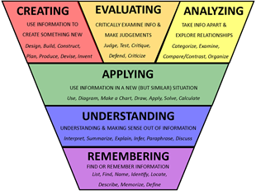

8-10th January 2018
Timed Exam Practice
Use the reading strategy taught to prep and plan your response.
Can you complete the task in the time recommended?
What is your individual target for improvement on this question?
How are you going to ensure you achieve or exceed your target grade?
Challenge is the tool with which teachers stretch students.

Slide 2


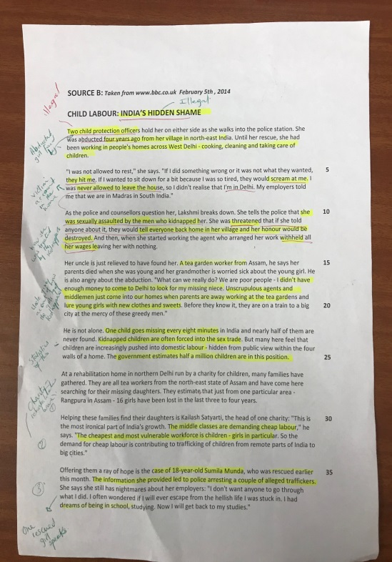
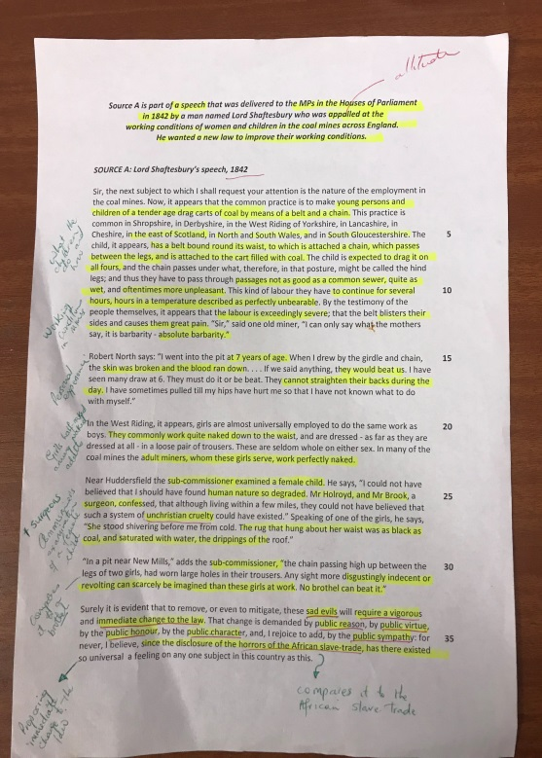
Fail to plan = plan to fail.
your English Exam Results by READING the extracts (texts) effectively.
Guarantee
by using your 15 minutes reading time effectively in 2 simple steps. How?
Read the text and highlight only the key points of each paragraph as you read.
Next, summarise briefly in the margin what that paragraph is about.
You will now know what the text is about + You have already highlighted key points, so evidence (quotes) are easy to find = Effective responses to all questions.
You can apply this technique to any subject that requires you to read a text and respond to questions.

Slide 3
TIMED EXAM PRACTICE
Spend 45 minutes on this question
MACBETH
Read the following extract from Act 1, Scene 7 and then answer the question that follows.
At this point in the play, Macbeth is speaking. He has just left the state dinner and is suddenly worried about their plan of killing King Duncan.
If it were done when 'tis done, then 'twere well
It were done quickly: if the assassination
Could trammel up the consequence, and catch
With his surcease success; that but this blow
Might be the be-all and the end-all here,
But here, upon this bank and shoal of time,
We'ld jump the life to come. But in these cases
We still have judgment here; that we but teach
Bloody instructions, which, being taught, return
To plague the inventor: this even-handed justice
Commends the ingredients of our poison'd chalice
To our own lips. He's here in double trust;
First, as I am his kinsman and his subject,
Strong both against the deed; then, as his host,
Who should against his murderer shut the door,
Not bear the knife myself. Besides, this Duncan
Hath borne his faculties so meek, hath been
So clear in his great office, that his virtues
Will plead like angels, trumpet-tongued, against
The deep damnation of his taking-off;
And pity, like a naked new-born babe,
Striding the blast, or heaven's cherubim, horsed
Upon the sightless couriers of the air,
Shall blow the horrid deed in every eye,
That tears shall drown the wind. I have no spur
To prick the sides of my intent, but only
Vaulting ambition, which o'erleaps itself
And falls on the other.
TASK:
Starting with the speech, explore how Shakespeare presents Macbeth’s state of mind.
Write about:
How Shakespeare presentsa Macbeth’s state of mind in the extract
How Shakespeare presents Macbeth’s state of mind in the play as a whole.
[30 marks]
AO4 [4 marks]

Slide 4

Self/PEER ASSESSMENT
Spend 45 minutes on this question.
MACBETH
Read the following extract from Act 1, Scene 7 and then answer the question that follows.
At this point in the play, Macbeth is speaking. He has just left the state dinner and is suddenly worried about their plan of killing King Duncan.
TASK:
Starting with the speech, explore how Shakespeare presents Macbeth’s state of mind.
Write about:
How Shakespeare presentsa Macbeth’s state of mind in the extract
How Shakespeare presents Macbeth’s state of mind in the play as a whole.
[30 marks]
AO4 [4 marks]
If it were done when 'tis done, then 'twere well
It were done quickly: if the assassination
Could trammel up the consequence, and catch
With his surcease success; that but this blow
Might be the be-all and the end-all here,
But here, upon this bank and shoal of time,
We'ld jump the life to come. But in these cases
We still have judgment here; that we but teach
Bloody instructions, which, being taught, return
To plague the inventor: this even-handed justice
Commends the ingredients of our poison'd chalice
To our own lips. He's here in double trust;
First, as I am his kinsman and his subject,
Strong both against the deed; then, as his host,
Who should against his murderer shut the door,
Not bear the knife myself. Besides, this Duncan
Hath borne his faculties so meek, hath been
So clear in his great office, that his virtues
Will plead like angels, trumpet-tongued, against
The deep damnation of his taking-off;
And pity, like a naked new-born babe,
Striding the blast, or heaven's cherubim, horsed
Upon the sightless couriers of the air,
Shall blow the horrid deed in every eye,
That tears shall drown the wind. I have no spur
To prick the sides of my intent, but only
Vaulting ambition, which o'erleaps itself
And falls on the other.
FOR AN EFFECTIVE RESPONSE:
Did you manage your time effectively?
Did you use the reading strategy to plan effectively?
Did you complete a fully structured essay style response?
Did you complete a close analysis of the extract using a judicious range of quotes?
Did you give a holistic view of his state of mind throughout the play; selecting the
Key scenes to explore?
Did you lead with and consistently make links to context, themes, writer’s intent and impact on audience throughout?
How effective is your AO4?
Did you achieve or exceed your target grade?

